Slide 1
Technology Treads in HealthCare
Student Name
Institution Affiliation

Slide 2
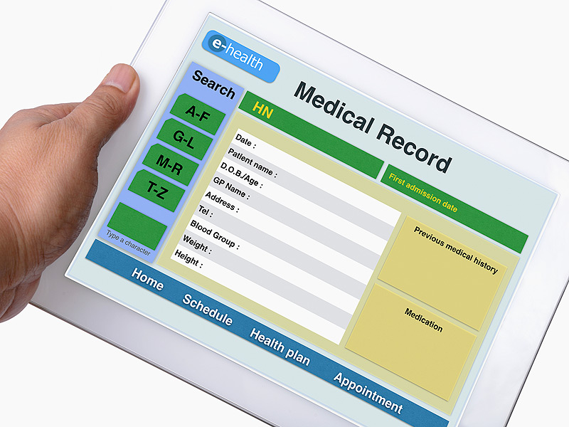
Types of Technology Trends Researched
Electronic Health records – used for lab tests, medication, allergies, and diagnosis of patients.
Medical Equipment - includes patient monitors, sterilizers, surgical tables, anesthesia machines, and infusion pump among others.
Notes:
Electronic health records is one of the most important technology trend in the healthcare industry. They are used in lab tests, medication, allergies, and diagnosis of patients. Additionally, medical equipment are also important especially in the delivery of care. Medical equipment's includes patient monitors, sterilizers, surgical tables, anesthesia machines, and infusion pump among others. These equipment are have their various uses in the health care industry. For instance, infusion pumps are used to infuse medication and fluids into the circulatory system of a patient. Surgical tables are used in surgery to lay patients. Generally medical equipment facilitate quality health care delivery.

Slide 3

Electronic Health Records (EHR)
Helps bring efficiency in the delivery of health services.
Streamlines operations at the hospital
Ensures that records are retrieved in a faster manner
Effective Implementation
Notes:
Electronic health records is the technology tread that I selected since I believe it is much helpful in the healthcare. Electronic health record (EHR) is an important technology that has helped bring efficiency in the delivery of health services. Organizations have adopted the use of electronic health records in order to streamline operations at the hospital and ensure that records are retrieved in a faster manner which in turn leads to patients being attended to promptly (Evans, 2016). Managers play a critical role when it comes to the implementation and management of electronic health records. They ensure that the technology is running smoothly and that any challenges arising out of the technology is urgently addressed. Managers are in charge of the operations of the hospital and thus it is critical that they ensure the electronic health records are working well in order to enhance the quality of patient care in the hospital.

Slide 4
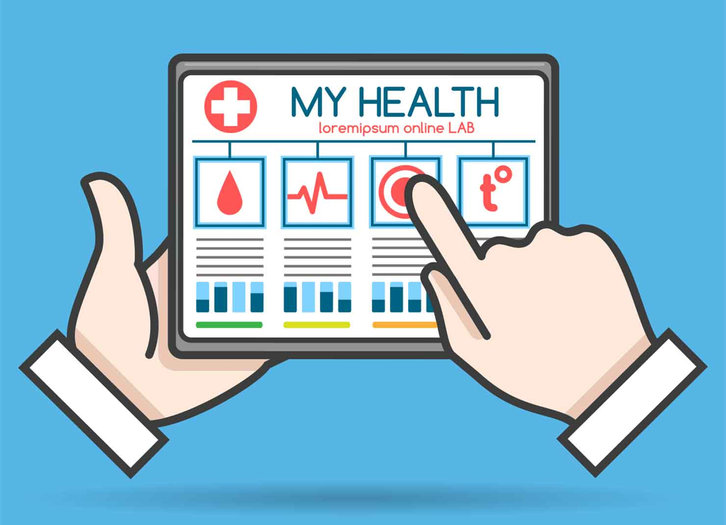
Benefits of Electronic Health Records
Enhances the delivery of services
Eliminates the need to conduct preliminary questioning of the patient every time they visit a health facility
Enables prompt send of records.
Notes:
Electronic health records have a lot of benefits when it comes to other users. It assist the nurses to retrieve health records in a faster way thus enhancing the delivery of services. This is in contrast to the manual records in which records take a lot of time to be retrieved. Furthermore, nurses can retrieve information regarding customers easily and therefore this kind of record keeping eliminates the need to conduct preliminary questioning of the patient every time they visit a health facility. Medical doctors also enjoy the benefits of this technology through the records that are sent promptly. They are able to access the health records of patient and proceed to diagnose and provide treatment to the patients. This is critical in ensuring that the hospital reduces instances of deaths and complications.

Slide 5
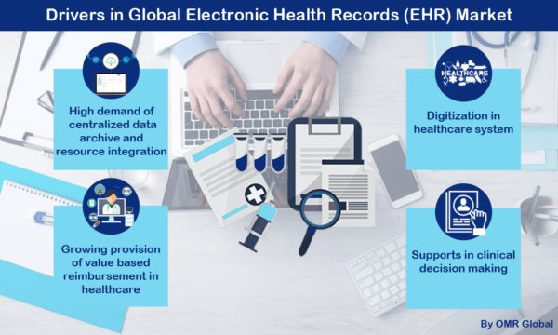
Impacts of Electronic Health Records
Quality health outcomes
Reduction of medication errors
Communication and interaction Improvements
Saves time
Improved the quality of hospital productivity
Notes:
Electronic health records support quality outcomes in that efficiency in which records are retrieved promote the speedy attendance to patients which in turn leads to high quality patient treatment outcomes (King, Patel, Jamoom & Furukawa, 2014). The technology assists in reducing medication errors that ensures patients get the right kind of service. It also improves communication and interactions between primary care providers and patients (Osmani, Li, Danieletto, Glicksberg, Dudley & Mayora, 2018). The primary care providers are able to ask for information regarding patients and get answers in a timely way. This reduces time lost in searching for health records before commencing treatment and thus enhances the quality of patient health services. Electronic health records also improve the quality of productivity of the hospital through the efficient delivery of health records and the timely treatment of patients.

Slide 6

Security Risks of EHR
Accessibility of log in details by unauthorized persons.
Availability of information to third party
Notes:
Electronic health records are important for health organization as it assists in the maintenance of health records in a proper manner. The health records are kept in the system which ensures that information is protected and that the retrieval of health records is faster. Although electronic health records are a much secure way of protecting health information, it may be faced with privacy risks. One such risk is that unauthorized persons may get access to the log in details and thus access sensitive information that might be private to the patient (Howe, Adams, Hettinger & Ratwani, 2018). This may lead to a leakage of such private information to the public and might result in the stigmatization of the patients. Another risk is that information may be sent to the wrong person thus availing critical private information to a third party. This is bound to infringe on the patients’ rights to privacy.

Slide 7
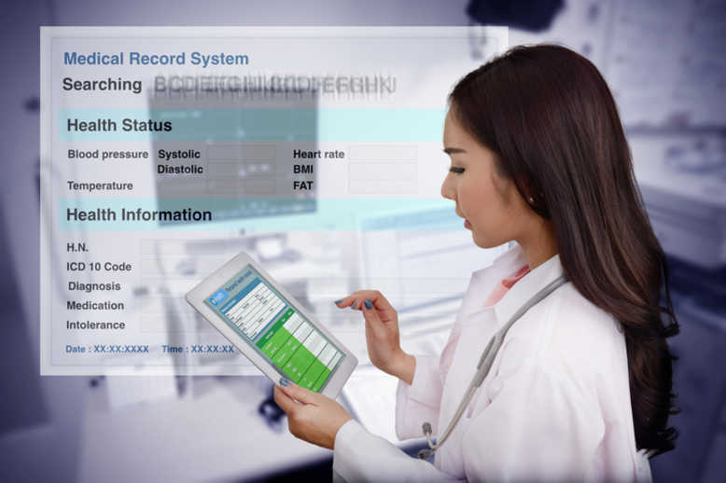
Privacy Safeguards of EHR
Passwords used by authorized employees in accessing records.
Server maintenance in secure rooms.
Backing up of information
Notes:
Electronic health records have several security safeguards that seek to protect the information of patients. There are passwords that are used by authorized employees to get access to the records (Evans, 2016). This is very important as it locks out people who may wish to access sensitive information for malicious actions. Electronic health record system servers are also maintained in secure rooms that are watched and guarded against tampering at all times looked. This is to ensure that the system is not stolen and critical information accessed. The information contained in the electronic health system is backed up to prevent its loss. This is important as there may be incidents of fire or theft that may destroy the information kept. Backing up information ensures that the normal services of the hospital go on.

Slide 8
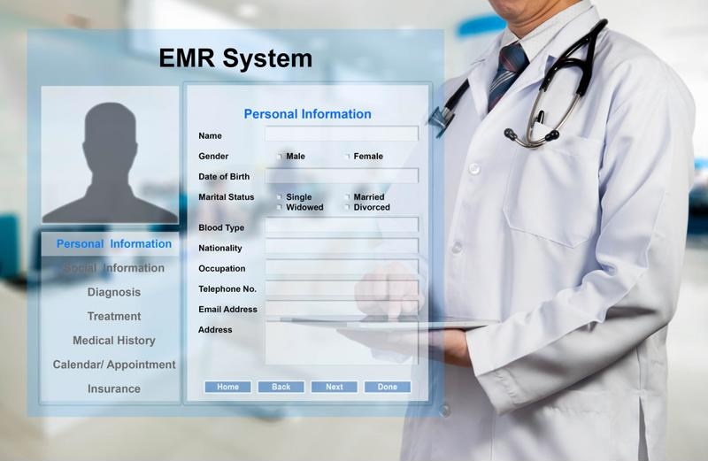
Strategies for Evaluating the Effectiveness of EHR
Performance of vulnerability tests
Checking on the rate of sending information
Notes:
One of the strategies of evaluating the effectiveness of electronic health records is by performing vulnerability tests. These are tests conducted on the system to determine if it can be easily penetrated by attackers. An effective electronic health record system will detect and deny entry unless is that of an authorized person (Evans, 2016). Another way is by checking on the rate of sending information. Doctors require information from the system to diagnose and prescribe appropriate medications. The rate at which information reaches the doctors determine the effectiveness of the technology. An efficient system will allow for an immediate transfer of records to the doctors to fasten the process of utilizing the information in administration of health services to patients.

Slide 9

Management's Role in this Technology Initiative
Management task force is required during implementation.
Management is responsible for planning, design, and implementation of EHR.
Build a better relationship with vendors
Notes:
The hospital management has several responsibilities during the entire process of decision making, choice and implementation of EHR. The management should come up with a task force that will be responsible to the entire process of implementation. The task force will have a project manager who will be responsible for coordination and completion of the entire process (Evans, 2016). The management as a whole should oversee the process of implementation and ensure that proper planning , designing and implementation is done. Lastly, the management is responsible to selection of the best vendor and build a strong relationship with the vendor selected.

Slide 10

Educational Need Training for Use of EHR
Acquisition of Technical Competency.
Opportunity to foster buy-in and commitment from administrators, providers and staff.
Creates opportunity to revisit the big picture goal of the hospital
Notes:
Training is necessary immediately after the implementation of EHR. Through effective training, all the healthcare professionals are able to acquire necessary technical competency. Therefore, everyone would be able to use the new technology. Additionally, carefully planned training is the opportunity to foster buy-in and commitment from administrators, providers and staff. Lastly, training will help the organization to revisit its outlined goals and see how the technology will helps in their accomplishment (Evans, 2016).

Slide 11
References
Evans, R. S. (2016). Electronic health records: then, now, and in the future. Yearbook of medical informatics, 25(S 01), S48-S61.
Howe, J. L., Adams, K. T., Hettinger, A. Z., & Ratwani, R. M. (2018). Electronic health record usability issues and potential contribution to patient harm. Jama, 319(12), 1276-1278.
King, J., Patel, V., Jamoom, E. W., & Furukawa, M. F. (2014). Clinical benefits of electronic health record use: national findings. Health services research, 49(1pt2), 392-404.
Osmani, V., Li, L., Danieletto, M., Glicksberg, B., Dudley, J., & Mayora, O. (2018). Processing of electronic health records using deep learning: a review. arXiv preprint arXiv:1804.01758.

Slide 12
Thank You
Thank you so much for listening!!!

